Slide 1
NDIS study and employment supports

Slide 2

Outline
  Background
  NDIS funding principles
  NDIS funded study supports
  NDIS funded employment supports
  NDIS planning meeting preparation and provider selection
  Questions
Information provided by the NDIA in this presentation is accurate at the time of recording. Please visit www.ndis.gov.au for the most up to date information.

Slide 3

Background

Slide 4

Options, pathways and supports
TAFE, university or other training
apprenticeship or traineeship
independent job seeking
volunteering to develop work skills and workplace confidence
NDIS school leaver employment supports to develop employment skills
NDIS funded employment related assessment and counselling; and assistance to find and keep a job
mainstream supports such as Disability Employment Services (DES)
on the job supports in a range of workplaces including open employment, Australian Disability Enterprises (ADEs), self employment, micro enterprises etc.
Notes:
NDIS participants have a number of employment and study options or pathways and supports available to them, depending on their stage of life and their goals and aspirations including:
TAFE, University or other training;
An Apprenticeship or Traineeship;
Independent job seeking;
Volunteering to develop work skills and workplace confidence;
NDIS School Leaver Employment Supports to develop the necessary skills for employment;
NDIS funded Employment Related Assessment and Counselling and assistance to find and keep a job;
Mainstream supports such as Disability Employment Services (DES); and
On the job supports in a range of workplaces including open employment, Australian Disability Enterprises (ADEs), self employment, micro enterprises etc.

Slide 5

What are mainstream services?
NDIS only funds work and study supports not funded or provided through other programs or services.
These programs or services are called mainstream services and are available to other Australians.
There are many mainstream services available to help a participant to work and study.
NDIS funded supports are the extra support that a participant needs because of their disability, not provided by mainstream services.
Notes:
NDIS only funds work and study support not funded or provided through other programs or services.
These programs or services are called mainstream services and are available to other Australians.
There are many mainstream services available to assist a participant to work and study.
NDIS funded supports are the extra support that a participant needs because of their disability not provided by mainstream services.
To find out more about what work and study supports the NDIS can fund, check the Work and study supports guideline on the NDIS website.

Slide 6

NDIS funding principles

Slide 7

What supports can the NDIS fund?
Supports to help move from school to further study, training or work.
Help to build their basic work skills.
Supports not available through Disability Employment Services (DES) to find and keep a job.
Training for teachers or work colleagues about a participant’s disability support needs.
Personal care during work or study.
Assistance to travel to and from work and study when their disability prevents use of public transport.
Notes:
NDIS participants can receive funding for work and study supports related to their disability such as:
supports to help move from school to further study, training or work;
help to build their basic work skills;
supports not available through Disability Employment Services (DES) to find and keep a job;
training for teachers or work colleagues about a participant’s disability support needs;
personal care during work or study; and
Assistance to travel to and from work and study when their disability prevents use of public transport.

Slide 8

What supports does the NDIS not usually fund?
Changes to building ramps, hoists and lifts.
Textbooks and computers for work or study .
Staff, supervision, learning support, tutoring, equipment, resources or fees required for
teaching / learning.
Cost of phone calls, photocopying, stationery, meals for training or work.
Equipment that an employer must provide to meet legal and business needs (e.g. safety equipment).
Equipment and other costs to start a business.
General training required of all employees.
Supports available through a DES provider.
To find out more about what work and study supports the NDIS does and does not fund, check the Work and study supports guideline on the NDIS website
Notes:
The NDIS does not usually fund:
Changes to building ramps, hoists and lifts;
Textbooks and computers for work or study;
Staff, supervision, learning support, tutoring, equipment, resources or fees required for teaching / learning;
Cost of phone calls, photocopying, stationery, meals for training or work;
Equipment that an employer must provide to meet legal and business needs, eg : safety equipment;
Equipment and other costs to start a business;
General training required of all employees; and
Supports available through a DES provider.

Slide 9
NDIS funded study supports

Slide 10

NDIS funding considerations
To be considered for funding, a support needs to be reasonable and necessary.
The local area coordinator or planner may consider:
other available supports that will achieve the same outcome at a lower cost
supports that will help the participant in the long term
supports that will help the participant become more independent, or reduce future support needs.
Notes:
To be considered for funding, a support needs to reasonable and necessary:
Help a participant pursue their goals
Be effective and beneficial; and
Be legal, safe and represent value for money.
The LAC or Planner will consider if:
Other supports will achieve the same outcome at a lower cost;
The supports will help the participant in the long term; and
The supports will help the participant become more independent, or reduce future support needs.

Slide 11

NDIA funding supports for university, TAFE and apprenticeships
These extra supports are considered:
personal care at university, TAFE and approved placements
transport if the participant can’t drive or use public transport
training for university, TAFE staff or employers (during placements) regarding the participant’s support needs
participation in specific projects run by the university/TAFE for people with disabilities.
Notes:
The NDIS can consider funding extra supports a participant needs because of their disability for university, TAFE, an apprenticeship or other training.
These supports should allow the participant to participate alongside their peers:
Personal care at university, TAFE and undertaking approved placements;
Transport if the participant can’t drive or use public transport;
Training for university, TAFE staff or employers (during placements) regarding the participant’s support needs; andParticipation in specific projects run by the university/TAFE for people with disabilities.

Slide 12

Supports NDIS does not fund for university, TAFE and apprenticeships
Supports that a university or TAFE need to provide as a ‘reasonable adjustment’ for a participant, or anything as part of usual teaching.
Changes to the buildings to make sure the participant can access it, like ramps.
Changes to a participant’s learning materials to make sure it suits their needs.
Textbooks or general equipment a participant needs for their education or training.
Course fees.
Participants can speak to their Support Coordinator, LAC or planner to find out what help is available in their local area.
Notes:
NDIS does not fund:
Supports that a university or TAFE need to provide as a ‘reasonable adjustment’ for a participant, or anything as part of usual teaching;
Changes to the buildings to make sure the participant can access it, like ramps;
Changes to a participant’s learning materials to make sure it suits their needs;
Textbooks or general equipment a participant needs for their education or training; and
Course fees.
Participants can speak to their Support Coordinator, LAC or planner to find out what help is available in their local area.
There are many support programs available, such as mentors and note takers for students with disability.

Slide 13

School responsibility
Primary and secondary schools are responsible for:
anything that is part of a student’s education and learning
reasonable adjustment for disability.
Schools must ensure a student with disability has the same opportunities as other students, to fully participate in class and other school activities.
Notes:
Primary and Secondary schools are responsible for:
Anything that is part of a student’s education and learning; and
Reasonable adjustment for disability.
Schools are to ensure a student with disability has the same opportunities as other students to fully participate in class and other school activities.

Slide 14

NDIS responsibility
NDIS may fund these extra supports:
Special training for teachers about a participant’s individual disability support needs.
Personal care support in a school environment, such as assisting with toileting needs and transport to and from school.
Support to do work experience or school-based traineeship.
Notes:
Primary and Secondary schools are responsible for:
Anything that is part of a student’s education and learning; and
Reasonable adjustment for disability.
Schools are to ensure a student with disability has the same opportunities as other students to fully participate in class and other school activities.

Slide 15

The NDIS does not fund
school fees
1:1 school / teachers assistants
excursion costs
required textbooks or standard technology
before and after school care
everyday living expenses
Notes:
The NDIS usually does not fund:
School fees;
1:1 school / teachers assistants;
Excursion costs;
Textbooks or standard technology as required by the school;
Before and after school care; and
Other things that everyone / non participants would need to pay for. These are known as “everyday living expenses”.

Slide 16

NDIS funded employment supports

Slide 17
How can NDIS funding assist?
Prepare for work
build aspiration for employment,
gain confidence in a work setting
establish foundation employment skills
develop an identity as a future worker
Get and keep a job
work experience
on-the-job support (supports in employment)
capacity building to manage complex work issues
Progress at work
skills development, over and above employer obligations
career planning
changing jobs

Slide 18
NDIS funded employment support categories
Workplace assistance
Employment related assessment + counselling
NDIS employment supports
School leaver employment supports
Supports in employment
Notes:
The purple categories are capacity building supports, which are in the Capacity Building budget of an NDIS plan.
These are generally time limited supports, focussing on growth and development and linked to specific employment goals.
Supports in employment are for participants who need an ongoing, higher level of day-to-day support than an employer or a DES can provide.
For NDIS plans reviewed after 1 July 2020, these supports will be placed in the Core budget.
Participants may have a mix of Core and Capacity Building Supports in their plans to help them.
(Reinforce all of this - really important for people to understand)

Slide 19

Employment related assessment and counselling
This capacity building support is designed to provide professional assessment/s and counselling to help participants successfully engage in employment.
These supports include:
vocational and/or functional assessments to inform employment potential and pathways for participants
counselling to help with:
  selection of the best pathways to employment
  education to build an inclusive workplace by providing information, education support to the participant, the employer and the work team
career counselling
This support sits under the therapeutic registration group.
Notes:
This capacity building support is designed to provide professional assessment/s and counselling to assist participants to successfully engage in employment.
These supports include:
Vocational and/or Functional assessments to inform employment potential and pathways for participants
Counselling to assist the selection of the best pathways to employment; education to build an inclusive workplace by providing information, education and support to the participant, the employer and the work team
Career counselling
This support sits under the Therapeutic Registration Group.

Slide 20

School leaver employment supports
For school leaving age participants who require supports to get work:
  typically for Year 12 students
  considerations for below Year 12 or
  those who have finished Year 12
  generally up to 22 years old.
For participants not ready to go straight into work and who need help:
  to learn more about work
  prepare for work.
Notes:
School Leaver Employment Supports are an early intervention approach for participants of school leaving age, helping to transition from school to employment.
Supports are available to young people who are in their final year of school, as well as those who have recently left school, generally up to age 22, who require support to transition to work.
School Leaver Employment Supports are typically for Year 12 students but can be considered for any student who has reached school leaving age and is looking to transition from school to work.
The legal schooling leaving age varies across states and territories in Australia. Participants should check the school leaving age requirements for their state or territory.
While some participants may be ready to move straight into looking for work after school, many need additional supports to help them learn more about work and what it might look like for them.
School Leaver Employment Supports helps participants understand their employment potential and gain the skills and confidence to work towards their employment goals.

Slide 21

School leaver employment supports
Help young people moving from school into employment.
Help participants explore their work potential.
Build skills, independence and confidence to reach employment goals.
Have a strong emphasis on trying and testing different work activities through work experience.
Generally delivered up to two years, with regular review against the participant’s goals.
Individualised and not a one size fits all approach.
Notes:
School Leaver Employment Supports assist young people with a disability to transition from school into employment. This assistance is available during a young person’s final years of school and directly after leaving school. Supports are designed to help participants explore and understand their work potential, and build skills, independence, and confidence to participate in employment.
Supports are tailored to the individual and designed to plan and implement pathways to employment, focussing on capacity building for the young person. With appropriate supports, it is expected many participants will move directly into employment or job seeking, sometimes with the assistance of a Disability Employment Service provider. Others may progress to self-employment while some may need longer term supports to obtain and retain employment.
Delivery of supports is individualised, with a strong emphasis on “trying and testing” through work experience in a range of settings. These on the job learning opportunities enable a participant to understand their work capability, how they best learn new skills and help build their confidence to move into employment.
These activities also inform the level and nature of future supports needed to obtain and sustain employment.
Providers of School Leaver Employment Supports will generally work with a participant up to two years, with periodic review against the participant’s goals.
School Leaver Employment Supports are not expected to be delivered as a program or a “one size fits all” approach. They are person-centred, individually tailored, strategic and planned supports for NDIS participants to help them reach their personal employment goals.

Slide 22
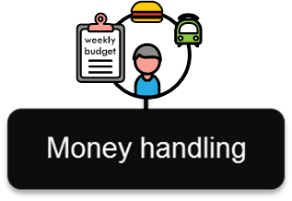


School leaver employment supports
Money handling
Time management
Discovery activities
Work experience in a range of settings
Learning how to take instruction at work
Travel training

Slide 23

Supports in employment
Supports to help participants with moderate to high support needs in a variety of employment settings:
a job in the public or private sector
a social enterprise or similar environment
a micro-business or family run business
an Australian Disability Enterprise (ADE)
supported work experience
volunteering activities.
Notes:
Supports in Employment funding enables participants with moderate to high support needs to be supported in a variety of settings such as:
a job in the public or private sector;
a social enterprise or similar environment;
a micro-business or family run business;
an Australian Disability Enterprise (ADE);
supported work experience; and
volunteering activities.

Slide 24

Supports in employment funding
Relatively intense or frequent and tailored to suit the needs and goals of the participant
Either one-to-one or group-based
Typically includes a combination of the following supports:
  on the job exploration and coaching
  job customisation
  on-the-job training and mentoring to support meaningful participation
  supports to manage complex needs at work
  non face-to-face activities that are directly related to supporting a participant’s employment.
Notes:
This on-the-job support is relatively intense or frequent and tailored to suit the needs and goals of the participant and is provided either one-to-one or group-based. Typically includes a combination of the following supports:
on the job exploration and coaching to understand how to harness a persons skills and abilities;
job customisation;
on-the-job training and mentoring to support meaningful participation
supports to manage complex needs at work; and
non face-to-face activities that are directly related to supporting a participant’s employment.

Slide 25
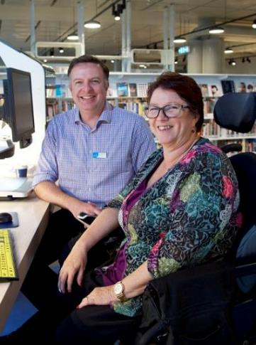
Participants preparing for NDIS planning meeting

Slide 26
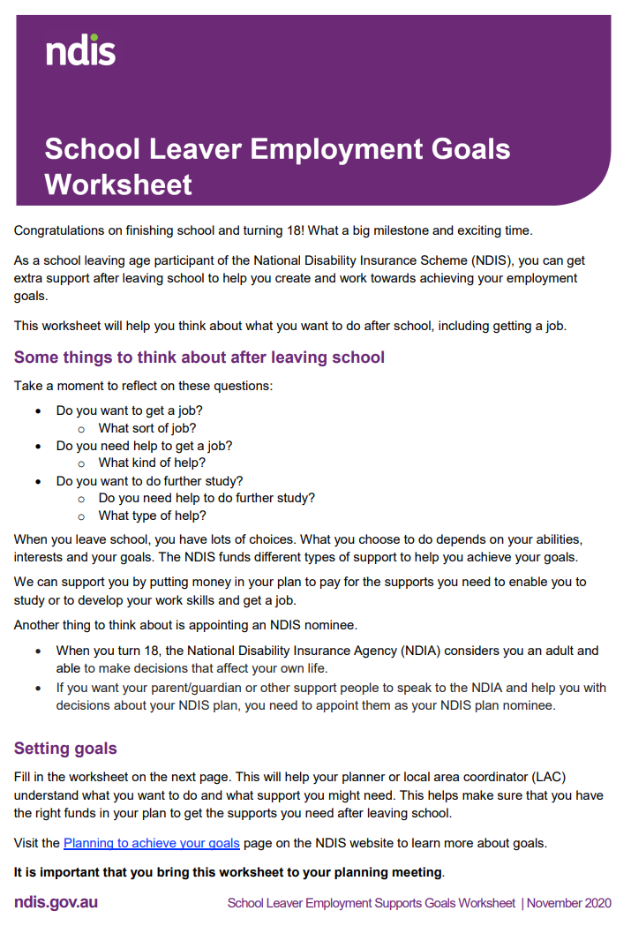

Preparing for an NDIS planning meeting
Completing these resources would be a good place to start for participants leaving school and preparing for work or study:
School leaver employment goals worksheet:
  helps participants think about what they may want to do after school, including getting a job
  check the Leaving school page on the NDIS website.
Let’s talk about work booklet:
  covers planning for employment, exploring employment goals, planning for leaving school and finding employment providers
  check the Let’s talk about work page on the NDIS website.
Notes:
For participants who are leaving school and preparing for employment or study, a good place to start is by completing the School Leaver Employment Goals Worksheet, which can be downloaded from the NDIS website.
They can also complete the “Let’s talk about work” booklet.
The booklet is available on the NDIS website and hard copies of the booklet are available at NDIS and Local Area Coordinator offices.
The booklet covers:
Planning for employment;
Exploring employment goals;
Planning for leaving school and;
Finding employment providers.

Slide 27

Preparing for an NDIS planning meeting
Copies of the following should be brought to the planning meeting with the LAC or planner:
  recent school reports and school career transition plan (for recent school leavers)
  vocational profile
  work experience reports
  references or reports from any part time work or volunteering activities
  relevant reports/assessments from professionals.
Completed goals worksheet and work booklet also need to be brought to the planning meeting.
Notes:
After completing the “Let’s Talk About Work” booklet and/or the School Leaver Employment Goals worksheet, a participant should gather the following documentation and bring the completed booklet and/or worksheet and copies of any of the following they have to their planning meeting with the Local Area Coordinator (LAC) or planner:
Recent school reports and school career transition plan (if a recent school leaver);
Vocational profile;
Work experience reports;
References or reports from any part time work or volunteering activities;
Copies of any relevant reports or assessments from professionals such as a Functional Capacity Assessment completed by an Occupational Therapist or a Vocational Interest report from a Counsellor.
A participant’s parent/carer, Support Coordinator or other support person can assist them to complete the booklet and gather the above information if required.

Slide 28
Provider selection

Slide 29
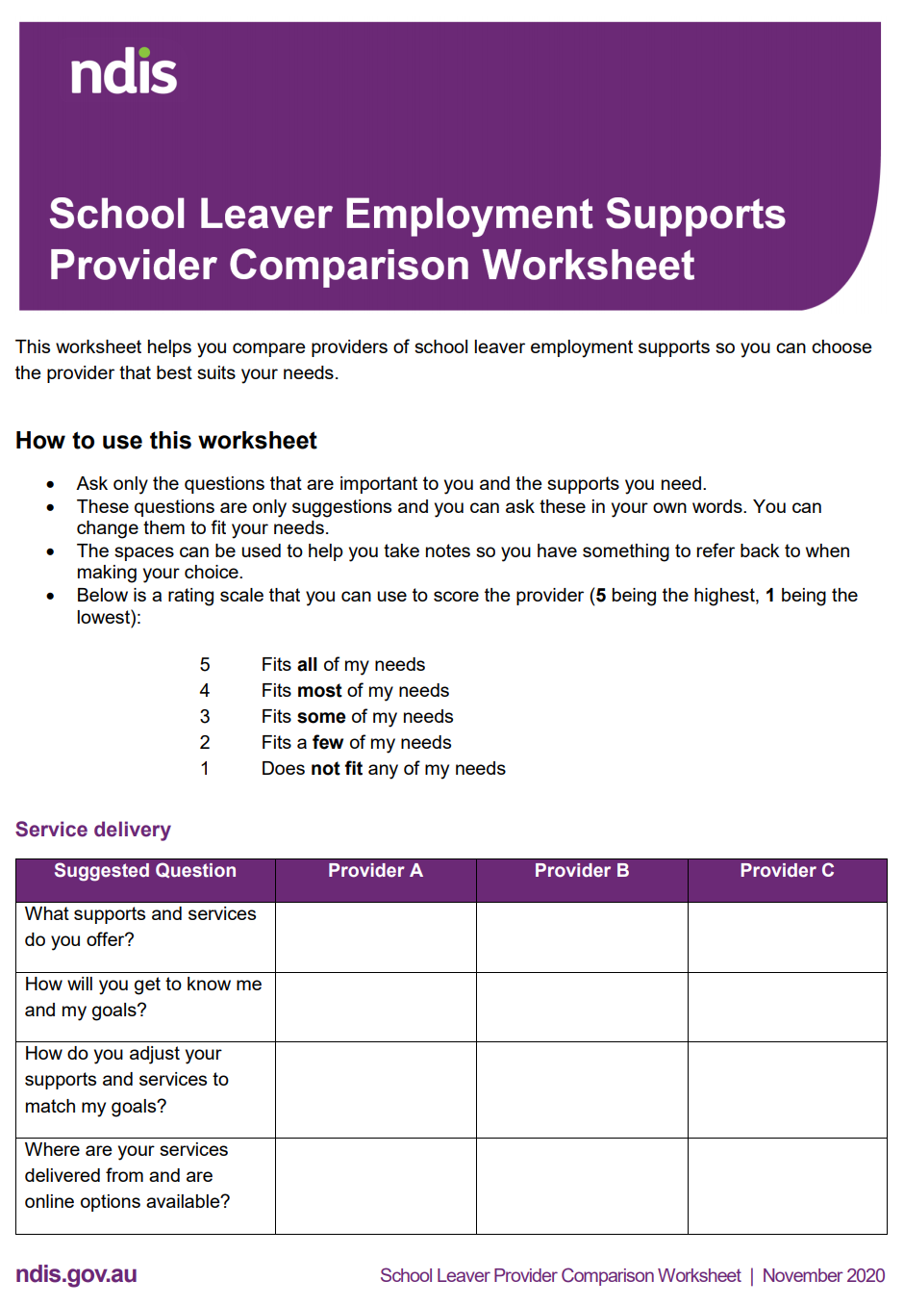
Selecting a suitable provider
Tips for participants when selecting providers:
speaking to their LAC or support coordinator
doing online research
attending expos and speaking to suitable providers
speaking to other participants (word of mouth / reputation).
Before making a decision, they can also:
meet and discuss service options with providers
attend ‘tasters’ or ‘trials’.
A School leaver employment supports provider comparison worksheet is on the NDIS website to help participants in choosing providers.
Notes:
Participants should research suitable providers by:
speaking to their Local Area Coordinator or Support Coordinator;
conducting online research;
attending expos and speaking to suitable providers;
speaking to other participants (word of mouth / reputation)
Meet, discuss service options and attend “Tasters” or trials with a number of providers before making a decision.
More than one provider can be selected to provide supports.
To assist participants in decision making, a School Leaver Employment Supports Provider Comparison Worksheet is published on the NDIS website.

Slide 30

Further information and resources
For general information and resources, visit the NDIS website on ndis.gov.au.
For information on Work and study supports, visit the Work and Study Operational Guideline page.
For information on Employment supports in general, visit the Employment page.
For information on Supports in Employment, visit the Supported Employment page.
For information on School leaver employment supports and to access the Provider comparison worksheet and the School leaver employment goals worksheet, visit the Leaving School page.
Notes:
For further information and resources visit the NDIS website www.ndis.gov.au.
For information on Work and Study Supports, visit the Work and Study Operational Guideline page www.ndis.gov.au/about-us/operational-guidelines/work-and-study-operational-guideline
For information on Employment Supports in general, visit the Employment page
www.ndis.gov.au/understanding/ndis-and-other-government-services/employment
For information on Supports in Employment, visit the Supported Employment page
www.ndis.gov.au/understanding/supports-funded-ndis/supported-employment
For information on School Leaver Employment Supports and to access the Provider Comparison worksheet and the School Leaver Employment Goals worksheet, visit the Leaving School page
www.ndis.gov.au/participants/finding-keeping-and-changing-jobs/leaving-school

Slide 31
Questions

Slide 32
Contact details
National Disability Insurance Agency
1800 800 110
ndis.gov.au
enquiries@ndis.gov.au
Find us on Facebook/NDISAus
Follow us on Twitter @NDIS
For people with hearing or speech loss
TTY: 1800 555 677
Speak and Listen: 1800 555 727
For people who need help with English
TIS: 131 450

